Slide 1
Learning disability annual health checks- information and resource pack for care and residential homes
Juliane.matthies@nhs.net
Juliane Matthies ICB lead GP learning disability and autism
Thank you to Vicki Cooper, Alice Cooper, Angie Hawkins, Tracy Pouard, Lynda Sandlers and the LeDeR governance group for feedback and input.

Slide 2
Learning disability annual health checks
This short presentation summarises everything you need to know about annual health check and health action plans.
It will take around 15 minutes to complete.
There are some additional slides on supporting your clients to staying health.
The word document gives you further information and links to carer and patient resources
Please click ‘enable content’ so you are able to watch the videos!

Slide 3
Annual health checks for people with learning disability
Here is a 4minute video about the annual health check
Please click enable content so you are able to watch the videos!

Slide 4
The GP learning disability register
Everyone with a learning disability should be on their GP’s register- this is a list of people with learning disabilities. Ensure the person you support is on the register so they don’t miss out on:
Reasonable adjustments to make it easier to access healthcare
An annual learning disability health check
A flu vaccination for them and their family and carers
This is a 1 and ½ minute video about the GP learning disability
register
Please click enable content so you are able to watch the videos!

Slide 5
Reasonable adjustments
Patients with learning disability have a legal right to reasonable adjustments; small changes the GP surgery can make to remove barriers when accessing healthcare
Reasonable adjustment can be:
longer appointment times and appointments at a certain time of day
waiting in a quiet area
easy read material
It is important to tell the surgery what reasonable adjustment a client needs before the appointment!
This is 3-minute video about reasonable adjustments
Please click enable content so you are able to watch the videos!

Slide 6
Health action plans
Outline any action after the annual health check.
Sets out when any action should be completed and who is responsible.
Should include ideas how to stay healthy.
This is 4-minute video
about health action plans
Please click enable content so you are able to watch the videos!

Slide 7
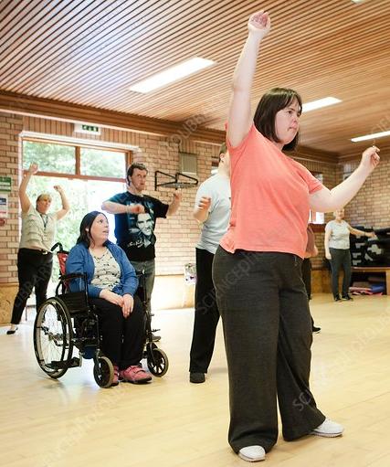
Staying healthy- Healthy eating, healthy weight and activity
People with a learning disability have a less balanced and healthy diet and are less active
Do you know if the person you look after has a healthy weight? Check their BMI and monitor their weight regularly to ensure it stays in the healthy range
Avoid using food as reward, choose activities that do not involve eating.
Make small changes over time, it will have a big impact on your client’s health. For example, swab to healthy snacks or smaller plates.
Being active improves our wellbeing, physical and mental health. It can help people develop new skills, socialise with others, be part of the community and fight boredom.
Everyone should be active for at least 150 minutes per week! Start step by step. Create an individual daily activity schedule.
Even people who rely on a wheelchair or have limited mobility can move more.
Be creative – make everyday tasks fun, involving more movement at the same time. Include reaching, stretching, catching activities.

Slide 8
Staying healthy- Oral and dental health for people with learning disability
important for people’s general health and quality of life
Poor oral health can cause pain, problems communicating and low self-esteem, problems chewing, swallowing, eating and enjoying food and it is associated with strokes, diabetes, heart and lung disease
Smoking, drinking alcohol above the recommended limit and poor diet high in sugar is bad for general health and teeth
Please help and support your client with twice daily brushing with toothpaste and regular 6 monthly dental checks
4 minute video for carers about dental health: Oral Health for people with a learning disability - YouTube

Slide 9
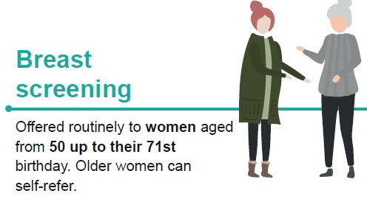
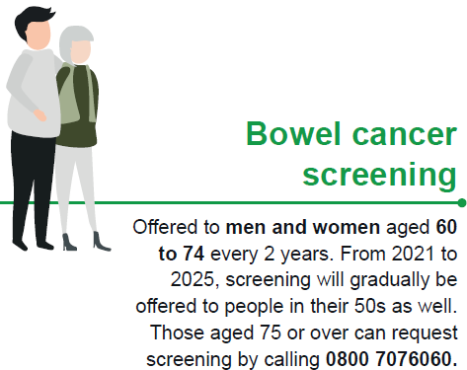
Screening
Support service users to attend screening appointments and do their tests when invited.
Earlier detection of cancers leads to better outcomes.
You can ask for reasonable adjustments - the contact number will be on the appointment letter.
There's lots of easy read and videos available to prepare people for the tests.
If you are worried about a service user coping with a screening test, contact their GP or call the Adult Learning disability Health Service for advice and guidance.
Do not ignore invitation letters or make assumptions that the person will not have a test – always ask if you have queries.

Slide 10
Thank you!
For any question ad feedback contact juliane.matthies@nhs.net

