Slide 1
Post Partum Psychosis (PPP) Pathway
Specialist Community Perinatal Mental Health Service

Slide 2
Post Partum Psychosis Pathway
REFER
Treat as Psychiatric Emergency
Refer to Local Intensive / Crisis Service
Highlight potential Post Partum Psychosis
Follow guidance - Page 5
RESPOND
Intensive / Crisis Team - Arrange face to face assessment within 4 hours
Seek specialist advice BNSSG 01179195826, BSW 01249767851, MBU 0117 3546690
Consider Mother & Baby Unit bed
Follow guidance - Page 6
TREAT
Initiate medication early
Maintain low threshold for admission to MBU
Follow guidance - Page 7
UNDERSTAND
Is this Post-Partum Psychosis? Check PPP Symptoms & Presenting Situation - Page 3,4 & 5
Do they present with one or more of the following Red Flags:
Recent significant change in mental state/new symptoms
New thoughts or acts of violent self harm, however fleeting
New and persistent expressions of incompetency as a mother/estrangement to infant
Post Partum Psychosis (PPP) Pathway

Slide 3
What is Post Partum Psychosis?
Post-Partum Psychosis is a severe, but treatable, form of mental illness that occurs after having a baby.
KEY BACKGROUND INFORMATION
PPP can emerge unexpectedly and deteriorate rapidly.
PPP is a PSYCHIATRIC EMERGENCY as risks to mother and infant can be extremely high and hard to predict.
Any suspected case should be treated as a PPP until it has been proven otherwise.
Most women will require medication AND admission to hospital.
An episode of PPP most often occurs in the first month post-delivery, but it can also so occur later than this.
Mothers with a previous history of bipolar affective disorder, schizoaffective disorder or those who have had a previous episode of post-partum psychosis will be at increased risk of PPP.
50% of affected mothers will have had no history of mental illness.
Post Partum Psychosis (PPP) Pathway

Slide 4
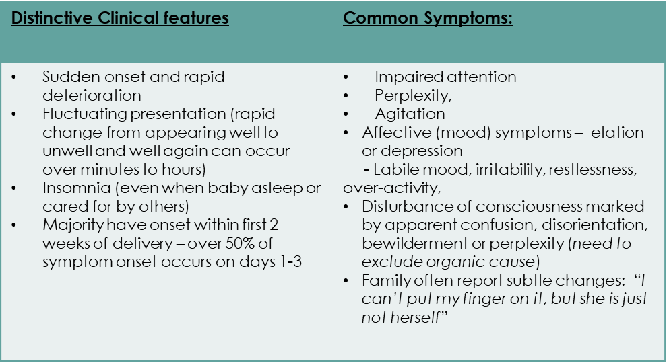
PPP Symptoms
Typical psychotic symptoms (hallucinations, delusions with content often related to the new baby) are often not present to start with and may only emerge later on.
Any psychotic symptoms, particularly delusions or hallucinations, substantially increase risk for both mother and baby.
Post Partum Psychosis (PPP) Pathway

Slide 5
ACTION 1 Understand and Refer
Clarify Presenting Situation
Has patient had a baby in the last year?
Does the patient present with any symptoms consistent with PPP?
Do they present with one or more of the following Red Flags :
Recent significant change in mental state/new symptoms
New thoughts or acts of violent self harm, however fleeting
New and persistent expressions of incompetency as a mother/estrangement to infant
Refer to mental health services
Treat as a PSYCHIATRIC EMERGENCY until proven otherwise
Refer immediately to your local Intensive service, stating this is a potential PPP.
If mum or baby in immediate danger call 999!
A four hour response by mental health services is essential. Any delay in appropriate assessment and treatment can lead to rapid deterioration and escalation of risk.
A lower threshold compared to non-perinatal patients should be maintained for accepting referrals, admissions and interventions. This is due to the additional risks posed to mother and infant and the fact that disorders in the early postpartum period can deteriorate quickly.
Post Partum Psychosis (PPP) Pathway

Slide 6
ACTION 2 Crisis Team Response*
MH professional should contact most appropriate person (service user, family member/carer or health social care professional) without delay and agree next steps to be provided in the service users care and support.
Crisis Team face to face assessment within 4 hours of referral is required.
Failure to provide an emergency referral and adequate assessment or start treatment immediately poses significant risk to mother and baby
Consider and assess the need for Safeguarding if Mother or baby is felt to be at risk
Refer to community perinatal mental health service within 1 working day awp.perinatalmentalhealthservice@nhs.net. - BNSSG awp.referralsbswperinatal@nhs.net - BSW
On call Consultant is available for advice and guidance or Perinatal Consultant Psychiatrist within working hours On call Rota’s are available on Ourspace or via AWP switchboard – 01225 325680 )
Specialist advice is available through - Mother and Baby Unit, all hours on 0117 3546690 Community Perinatal Teams during working hours BNSSG 01179195826 & BSW 01249767851
Prior to assessment check Webbeds for MBU bed availability: https://www.nhswebbeds.co.uk
*Liaison Psychiatry if service user is presenting at hospital emergency department
NICE recommend treatment of Mum and baby together. Severity of symptoms and nature of risk may result in MBU not being an appropriate environment. This should be considered as part of MBU discussion.
“There should be an expectation of early consultant involvement in assessment & management” MBRRACE-UK 2018
Post Partum Psychosis (PPP) Pathway

Slide 7
ACTION 3 Emergency Medical Treatment
Exclude physical health cause i.e delirium
Maintain low threshold for admission to MBU
Aim to keep mum/baby together unless risks posed to baby’s safety
Initiate antipsychotic treatment early; we recommend Olanzapine or Quetiapine which are both effective and suitable for use while breastfeeding.
Consider use of Lorazepam if required to manage acute agitation
Regularly Review diagnosis in light of physical health/blood results etc
Further medical resources:
LactMed https://www.ncbi.nlm.nih.gov/books/NBK501922/
BUMPs bumps - best use of medicine in pregnancy: medicinesinpregnancy.org
Choiceandmedication Avon and Wiltshire Mental Health Partnership Trust Home (choiceandmedication.org
Predicting Risk for PPP
Background rate 0.1-0.2% (1-2/1000)
If bipolar affective disorder Type I or Schizoaffective disorder – 20%
If bipolar/schizoaffective disorder and female first degree relative had PPP – 50%
If have bipolar/schizoaffective disorder and previous PPP – 50%
If had previous PPP – 50% in next pregnancy
If first degree relative had PPP - 3%
Post Partum Psychosis (PPP) Pathway

