Slide 1
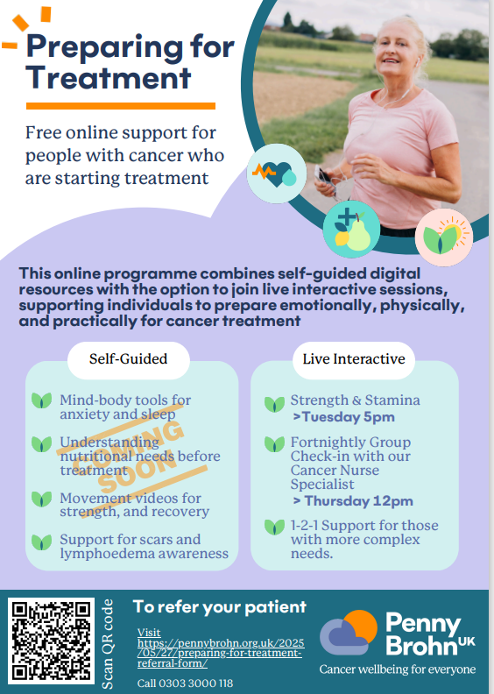
This programme is free to attend for all those living in Bristol, North Somerset and South Gloucestershire.
2025 new exercise offers – Interested in participating please phone 0117 4145550
or email: proactiveproject@nbt.nhs.uk

