Slide 1
Haematology in Primary Care
Dr sita Elsaesser (haematology clinical/educational fellow)
Dr amanda Clark (consultant in haematology)

Slide 2
Topics
B12/Anaemia
Platelets
Leucopenia/ neutropenia
Questions and cases will be covered within each

Slide 3
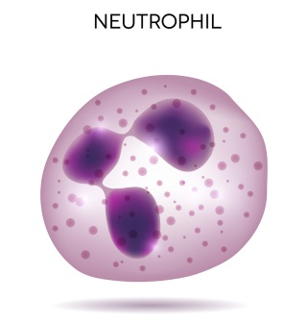
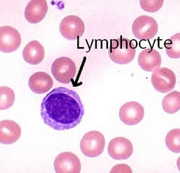
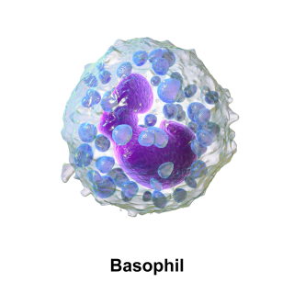
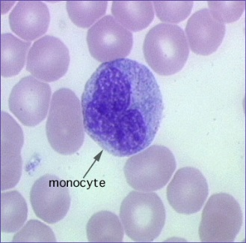
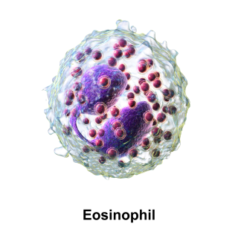
Interpreting a Full Blood Count
 | Normal Range
White cell count | 4 – 11 x 10⁹/L
RBC | 4.5-6.0 x 10¹²/L
Haemoglobin | 130-170 g/L
Haematocrit | 0.4 -0.52 L/L
MCV | 83 – 100 fL
MCH | 27-32 pg
MCHC | 310-350 g/L
Platelets | 150-450 x 10⁹/L
Neutrophils | 1.5-8 x 10⁹/L
Lymphocytes | 1-4 x 10⁹/L
Monocytes | 0.2 -1 x 10⁹/L
Eosinophils | 0.0 – 0.5 x 10⁹/L
Basophils | 0.0 – 0.2 x 10⁹/L
Notes:
Isolated abnormalities less important.

Slide 4
B12 deficiency
Macrocytosis
Excess alcohol
Liver disease
Reticulocytosis
Medications
B12/Folate deficiency
Monoclonal protein
Myelodysplastic syndrome
Pregnancy
Hypothyroidism (rare)

Slide 5
Red Flags & Investigations
Red Flags
Suspected myelodysplastic syndrome (based on blood film report) Other primary haematological cause suspected MCV > 100fl with accompanying cytopaenia (excluding in B12 / folate deficiency) Persistent unexplained MCV > 105fl
Investigations in Primary Care
Alcohol history and appropriate lifestyle modification B12 and folate levels (consider sequential Intrinsic Factor antibodies and coeliac screen) Blood film examination and reticulocyte count Liver and thyroid function tests Immunoglobulins and protein electrophoresis.

Slide 6
B12 deficiency
Vitamin B12 level | Action
< 150 ng/l | B12 deficiency likely
150-200 ng/l | Possible B12 deficiency. Consider repeat in 1-2 months.
> 200 ng/l | B12 stores normal. Stores adequate for at least 2 years
Anti-intrinsic factor antibodies: test regardless of vitamin B12 level if pernicious anaemia is suspected.
Trial of vitamin B12 if clinical suspicion but indeterminate vitamin B12 levels:
Patient wellbeing improves after a couple of days
Increased reticulocyte count at 1 week with a normalizing full blood count at 8 weeks
Neurology improves after 6-12 weeks.

Slide 7
Special Situations
Pregnancy: Vitamin B12 testing should be avoided in pregnancy as results are unreliable
Oral contraceptive pill
Food-B12 malabsorption (e.g. metformin): only test if strong clinical suspicion. Trial of oral cyanocobalamin could be considered and reviewed at 6 months. Can use diet measures
Notes:
Metformin and B12. Approx 10-30% of patients taking continuous metformin have evidence of B12 malabsorption. And it has also been shown that metformin decreases B12 levels by 14-30%. This appears to be both dose and treatment length dependant There have been postulations that this is due to bacterial overgrowth but studies have shown a direct effect on B12 absorption in the absence of any bacterial overgrowth.
The B12-intrinsic factor complex uptake by ileal cell membrane receptors is calcium-dependent. Metformin: affects calcium dependant membrane action. This results in a reduced uptake of B12. Studies have shown that taken normal over the counter multivitamins does not appropriately replace the B12 levels in these patients (one study suggested a minimu of 6 micrograms as replacement therapy).
Another study (only 21 patients though) showed that the B12 deficiency can be reversed by taking calcium..

Slide 8
High B12
This is often a non-pathological finding and rarely due to a haematological condition.
Vitamin B12 may be elevated in haematological malignancy including myeloproliferative disorders

Slide 9
Discussion
Questions
Cases

Slide 10
Anaemia
<130g/l Hb in an adult male <120g/l Hb in an adult female
RED FLAGS
Blood film report suggests primary haematological disorder Thrombocytopenia or neutropenia Splenomegaly or lymphadenopathy Reticulocytosis (without obvious bleeding) Unexplained, progressive, symptomatic anaemia An M protein, abnormal serum free light chain assay or positive urine light chains (Bence Jones protein)

Slide 11
Investigations in Primary Care
Microcytic | Normocytic | Macrocytic
Ferritin CRP iron studies for transferrin saturation or ZPP +/- reticulocyte count for Ret Hb Consider Hb electrophoresis | Vitamin B12, folate, ferritin, renal function, liver function tests, reticulocyte, CRP. Consider assessment of blood film, serum protein electrophoresis. | Review medical history Assess vitamin B12*, liver function tests, reticulocyte count blood film. Consider assessment of serum protein electrophoresis, GGT, LDH, TSH
*not reliable in pregnancy or COCP
Notes:
ZPP - zinc protoporphyrin
Hb electrophoresis is for β thalassaemia trait.

Slide 12
Inappropriate Referrals
Haematology referral is unlikely to be suitable for:
Elderly/frail patients with mild (Hb >100g/l), unexplained asymptomatic anaemia
Clinical Haematology referral is not appropriate for:
Iron deficiency anaemia
B12 or folate deficiency – can be managed according to BNF guidance in the community
Patients with anaemia of chronic disease or renal failure–consider referral to the relevant specialist team.

Slide 13
Discussion
Questions
Cases

Slide 14
Platelets - Thrombocythaemia
Causes | Investigations
Infection Inflammation Iron deficiency Surgery, trauma or blood loss Primary myelodysplastic disorder (e.g. essential thrombocythaemia) | Blood film Ferritin CRP Consider JAK2 if no reactive cause
RED FLAGS:
Arterial/venous thrombosis, neurological symptoms, abnormal bleeding
Notes:
Focus on: debate surrounding JAK2. NBT advise they see patients and do JAK2. Quite useful to have JAK2 before clinic. Can send JAK2 to UHB but may get asked ‘have you discussed it with a haematologist’ if send it to NBT lab.
In ET – JAK2 only positive in 50% of patients. If think it is secondary it is useful as a supportive negative. In PCV JAK2 positive in 90-95%.
NBT and UHB : upper limit changed (from 400->450). New paper suggesting above 400 in males there is increased risk of malignancy.

Slide 15
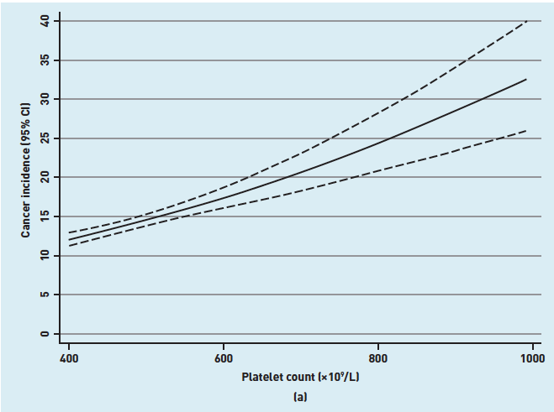
Cancer likelihood relative to platelet count
Males
Females
Bailey, S.E., Ukoumunne, O.C., Shephard, E.A. and Hamilton, W., 2017. Clinical relevance of thrombocytosis in primary care: a prospective cohort study of cancer incidence using English electronic medical records and cancer registry data. Br J Gen Pract, 67(659), pp.e405-e413.
Notes:
Prospective cohort study with 40 000 patients over 40 years with a platelet count over 400 and 10 000 matched patients with normal platelet count
Overall – males with platelet count > 400 had an incidence of 11.6% of cancer in the following year and females had an incidence of 6.2%
Lung and colorectal cancers were the most common sites. IN the lung and colorectal cancer patients one third of the patients had no symptoms warranting urgent investigation under NICE guidance other than thrombocytosis.
Current NICE guidelines only recommend thrombocytosis investigating raised platelet count in conjunction with specific symptoms e.g. weight loss, nausea, vomiting, dyspepsia, reflux, upper abdominal pain. With in a patient over 40 years it recommends an urgent CXR (less than 2 weeks) to check for lung cancer

Slide 16
Referral
Platelet count > 1000x10⁹/l
Platelet count 600-1000x10⁹/l in associated with: recent arterial/venous thrombosis (incl. DVT, PE, CVA, TIA, MI/unstable angina, PVD), neurological symptoms, abnormal bleeding, > 60 years
Persistent (> 3months) unexplained platelet count > 450x10⁹/l
Urgent OP assessment
Refer for OP assessment
Refer for specialist opinion

Slide 17
Discussion
Questions
Cases

Slide 18
Thrombocytopenia
Causes | Investigations
Immune Drugs Acute or chronic infections Marrow dysfunction Liver disease Hypersplenism Haematinic deficiency Microangiopathic haemolysis Pregnancy specific | Repeat FBC and blood film Renal, liver function & LDH If bruising/bleeding – PT/PTT/fibrinogen Consider discontinuing precipitating medication
RED FLAGS:
Bleeding, splenomegaly, lymphadenopathy, pregnancy, upcoming surgery

Slide 19
Referral
Platelet count < 50 x10⁹ /l (confirmed on repeat testing).
Platelet count 50-100x10⁹ /l in association with:
other cytopenias (Hb <100 g/l, neutrophils < 1x109/l),
Splenomegaly
Lymphadenopathy
Pregnancy
upcoming surgery
Persistent unexplained platelets < 100x10⁹/l,
Thrombocytpenia in patients with history of thrombosis
Platelet count < 20 or bleeding or red cell fragments or blasts on film
Platelet clumping on film.
Urgent discussion with on call haematology SPR/consultant
Refer for prompt OP assessment
Refer for specialist opinion
no referral necessary if count > 100x10⁹/l on citrate sample.
Notes:
Consider discussing: queries relating to antiplatelets and anticoagulants. Safe if platelet > 50 for anticoagulants if not other contraindications. If high CHADVASC/thrombotic risk may consider continuing down to platelet count of 30 (although at this point would be discussing with haem). For single agent antiplatelets it’s safe down to 20 (assuming no bleeding etc). Dual antiplatelets -> down to 30 -50, individual circumstances.

Slide 20
Discussion
Questions
Cases

Slide 21
Neutropenia
Causes | Investigations
Transient – viral infections Persistent: Benign ethnic neutropenia, autoimmune Splenomegaly Drug related Haematological disorders | Blood film Thorough history
RED FLAGS:
Neutrophil count < 1
Fever

Slide 22
Referral
Neutrophils < 1x10⁹/L
Neutrophils 1-1.5x10⁹/l
Patient unwell/febrile – URGENT ADMISSION
Patient well: Review medications, & inform patient to report promptly if fever. Repeat FBC with blood film in 48 hours and again in 2 weeks. If persists -> refer to haematology
Well with otherwise normal FBC – repeat blood film at 6 weeks. REFER to haematology if: progressive/symptomatic severe or DISCUSS with haematologist If persistent but stable
Other blood count abnormality present and persistent on 2 occasions at least 6 weeks apart or patient unwell – refer to or discuss with haematology
If ethnic neutropenia suspected: confirm with repeat FBC and confirm normal morphology with blood film. No need to refer unless diagnostic uncertainty.

Slide 23
Lymphopenia
Assessment in primary care
Any symptoms suggestive of primary immunodeficiency (e.g. recurrent infection particularly respiratory, combined with autoimmune disorders) Any implicated medications or excess alcohol? Symptoms or signs of systemic illness (e.g. infection, autoimmune disease, malignancy, malnutrition)? Symptoms or signs of a lymphoproliferative disorder?
Red Flags
Suspected lymphoproliferative disorder (i.e. other abnormalities on FBC, B symptoms, splenomegaly)

Slide 24
Who to refer
Infants and children with persistent lymphopenia -> immunologist
Symptomatic patients -> relevant specialist on the basis of the aforementioned investigations
Only refer to haematology if a lymphoproliferative disorder is suspected.

Slide 25
Investigations in Primary Care
Investigations in Primary Care
Elderly, asymptomatic patients with a lymphocyte count >0.5 do not require further investigation Other patients: Repeat FBC and film in 6 weeks to confirm persistence Renal and liver function Consider HIV, hepatitis B and C serology Consider autoantibody screen depending on symptoms Serum immunoglobulins
Asymptomatic, well patients with an isolated lymphopenia and no abnormalities on the investigations above do not necessarily need referral. Consider repeat FBC and film in 6 months.

Slide 26
Discussion
Questions?
Cases?

Slide 27
References
UHB haematology guidelines: https://remedy.bristolccg.nhs.uk/adults/haematology/guidelines-for-primary-care/

Slide 28
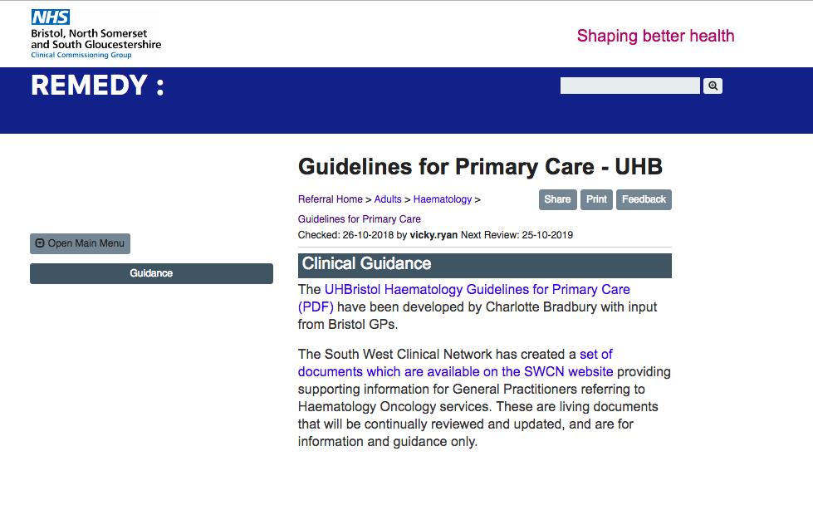
Current Guidelines

Slide 29
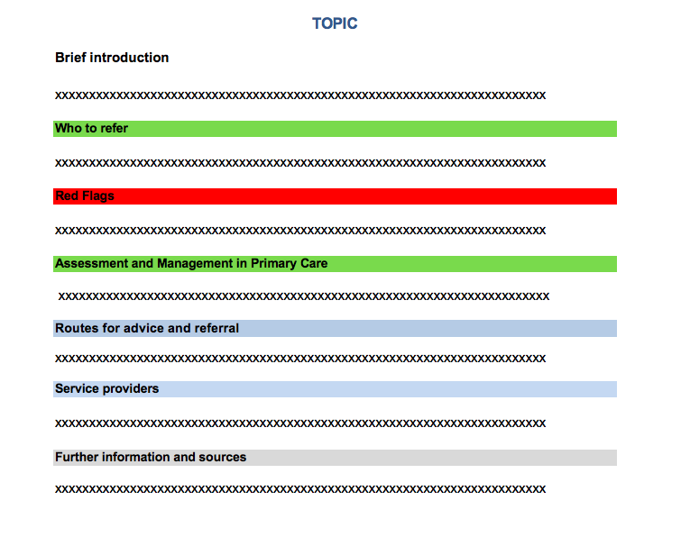
Proposal for new guidelines

Slide 30
Questions?

