Slide 1
Management of diabetic patients undergoing elective surgery
Helen Williams (ST6 Anaesthetics)
Simon Lewis (Consultant Anaesthetists)

Slide 2
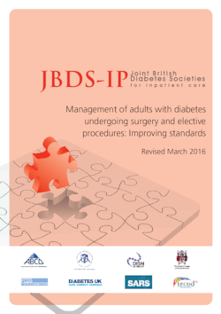
Diabetic patients undergoing surgery
Diabetic patients have greater complication rates, mortality rates and length of stay
Diabetic management should be optimised (HbA1c < 69 mmol/mol)
Elective surgery should be delayed if it is ≥ 69 mmol/mol while control is improved
Refer back to GP

Slide 3
Pre-operative assessment clinic
17,300 patients/year
1364 diabetic patients/year (8%)
1068 (78%) HbA1c ≤69 mmol/mol
- Median 49 (IQR 13)
288 (21%) HbA1c >69 mmol/mol
- Median 79 (IQR 19)

Slide 4
Patients with HbA1c ≥69

Slide 5
Diabetic patients with HbA1c >69mmol/mol
288 (21%) patients
96 (33%) had surgery delayed
36(38%) had surgery
89% improved control
11% emergency surgery
60 (62%) still waiting for surgery

Slide 6
Waiting times for surgery

